Slide 1
The Scatter
The Scatter

Slide 2
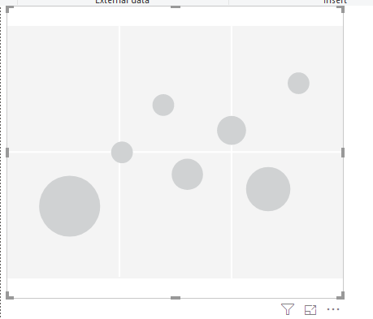
The dispersion
Note: Data is Since AdventureWorksDW2016 Database
Add a

Slide 3
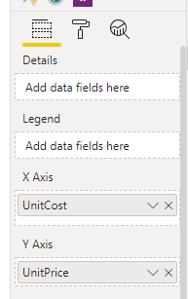
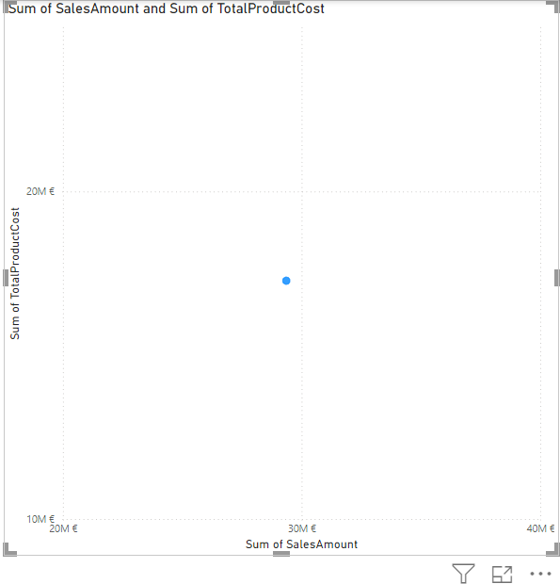
The dispersion
To use Scatter you need to have two variables or two measures to use in this case it is SalesAmount and TotalProductCost from FactInternetSales painting we add them respectively on the X and Y axes

Slide 4
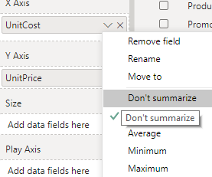
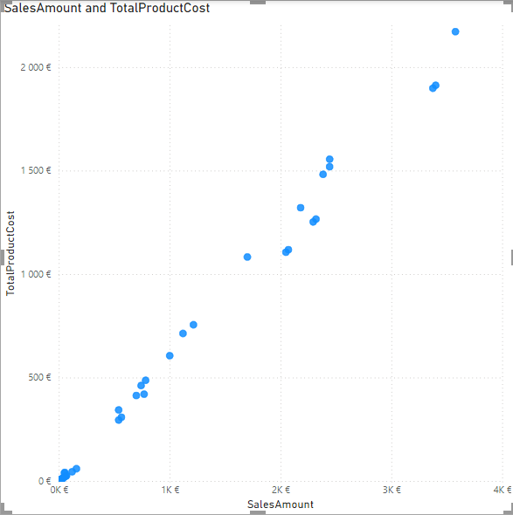
The dispersion
You need to turn off aggregation for one or both metrics to get the number below

Slide 5
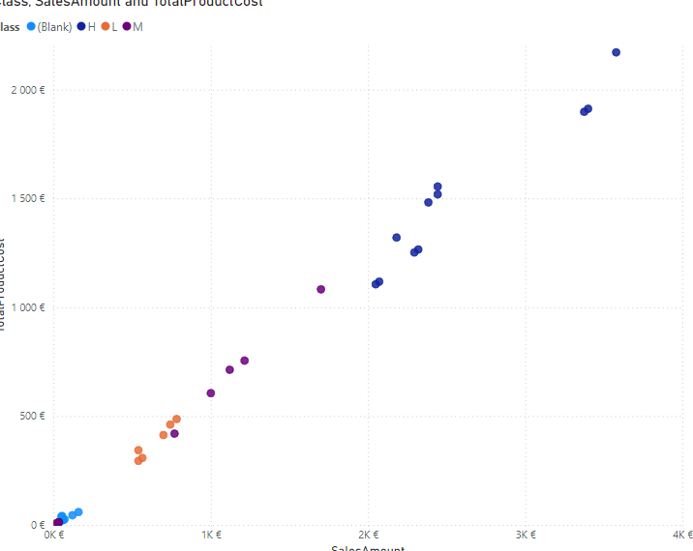
The dispersion
It should be noted that the reading of the data is still not conclusive.
Add a class from DimProduct table at the legend level and aggregate the two measures again

Slide 6
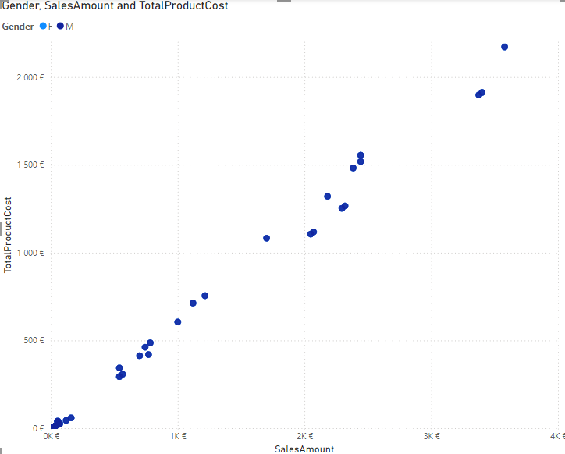
The dispersion
DimProduct replacement class with gender from DimCustomer painting and pay particular attention to outliers

Slide 7
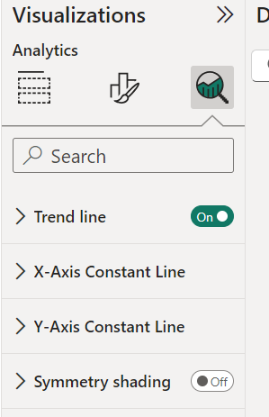
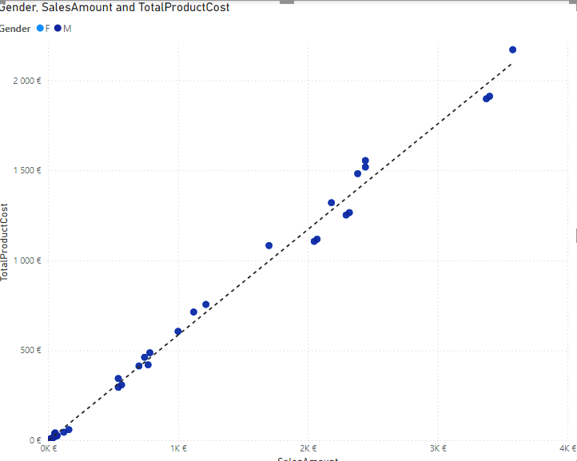
The dispersion
Try enabling the trend line from Analytics

Slide 8
Thank you
Thank you

